Slide 1

Testbed for Validating Second-Generation TDI and Clock Noise Correction for LISA
Karin Kruuse, Reid Ferguson, Sourath Ghosh, Patrick Krieger, Daniele Vetrugno, Guido Mueller Max Planck Institute for Gravitational Physics/Leibniz University Hannover
Notes:
This is a status report

Slide 2
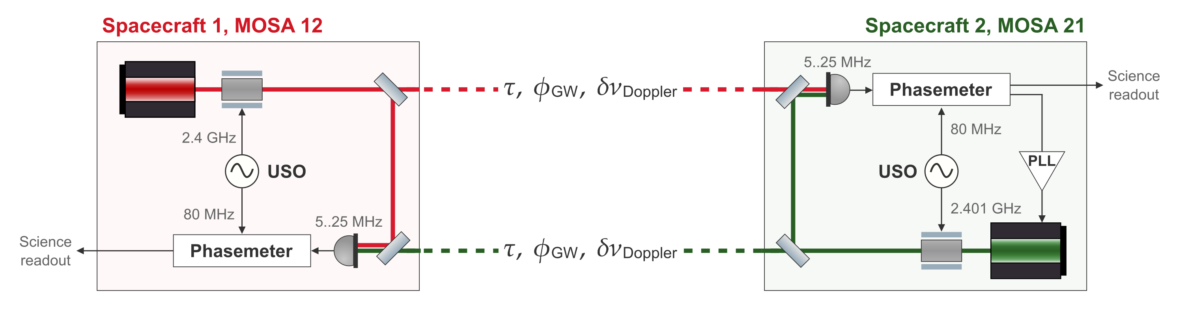

LISA Science Interferometer
Two primary noises in the LISA raw data – laser noise and clock timing jitter
Notes:
Simulations can only test what you think to simulate

Slide 3
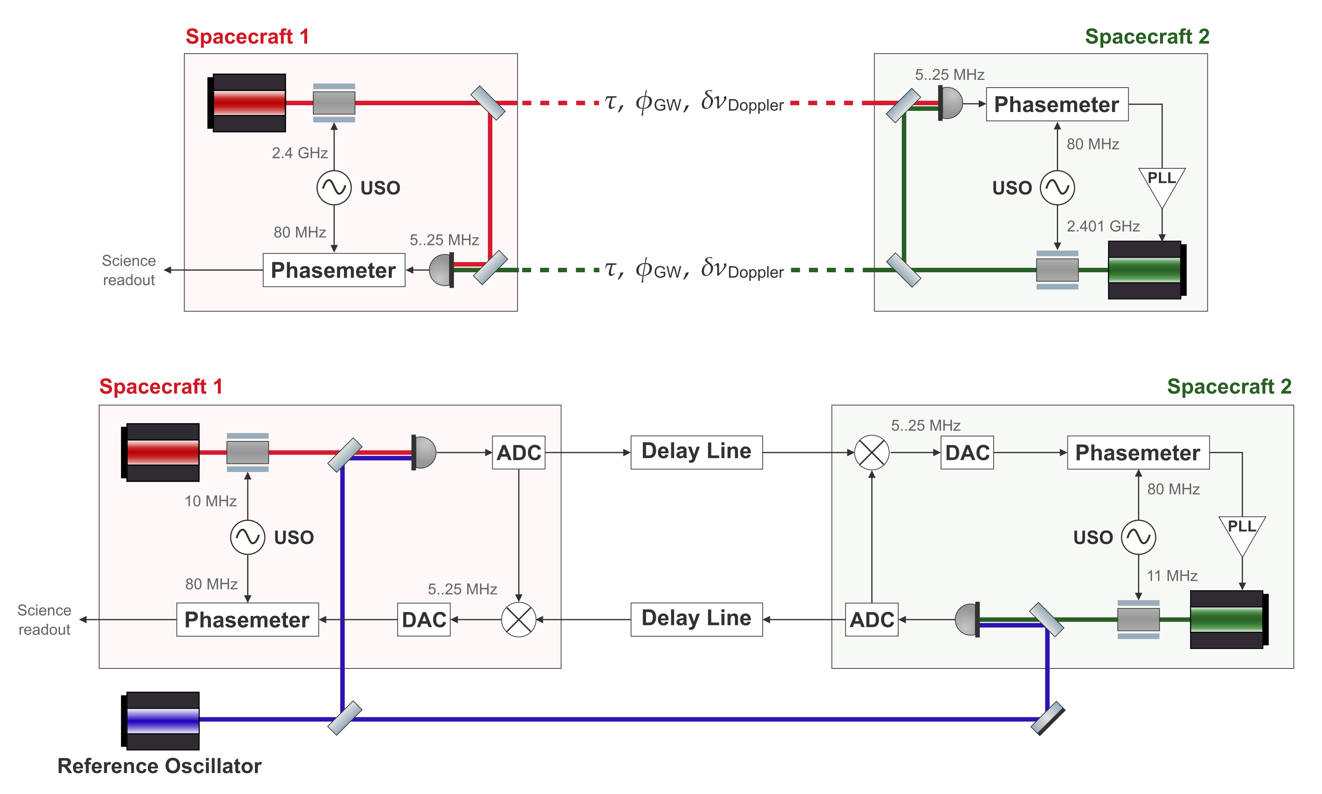
Replicating the LISA Arm in the Lab
LISA arm
Testbed arm
Notes:
Add subtext to the “titles”

Slide 4
Replicating the LISA Arm in the Lab
LISA arm
Carrier from 281 THz to ~50MHz
Testbed arm

Slide 5
Replicating the LISA Arm in the Lab
LISA arm
Inter-satellite interferometers
Testbed arm

Slide 6
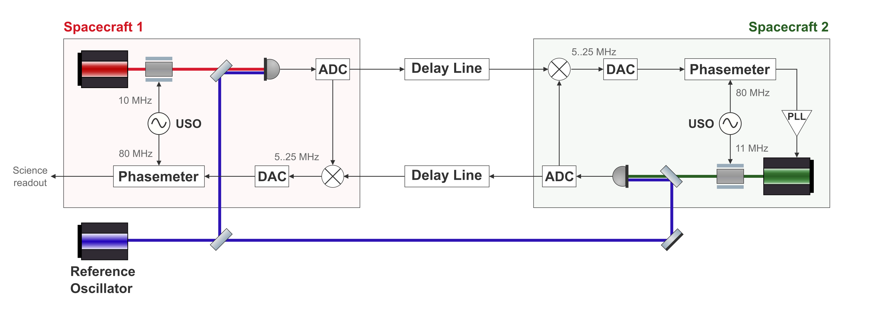

Replicating the LISA Arm in the Lab
LISA arm
Testbed arm
Notes:
Fix the signs

Slide 7
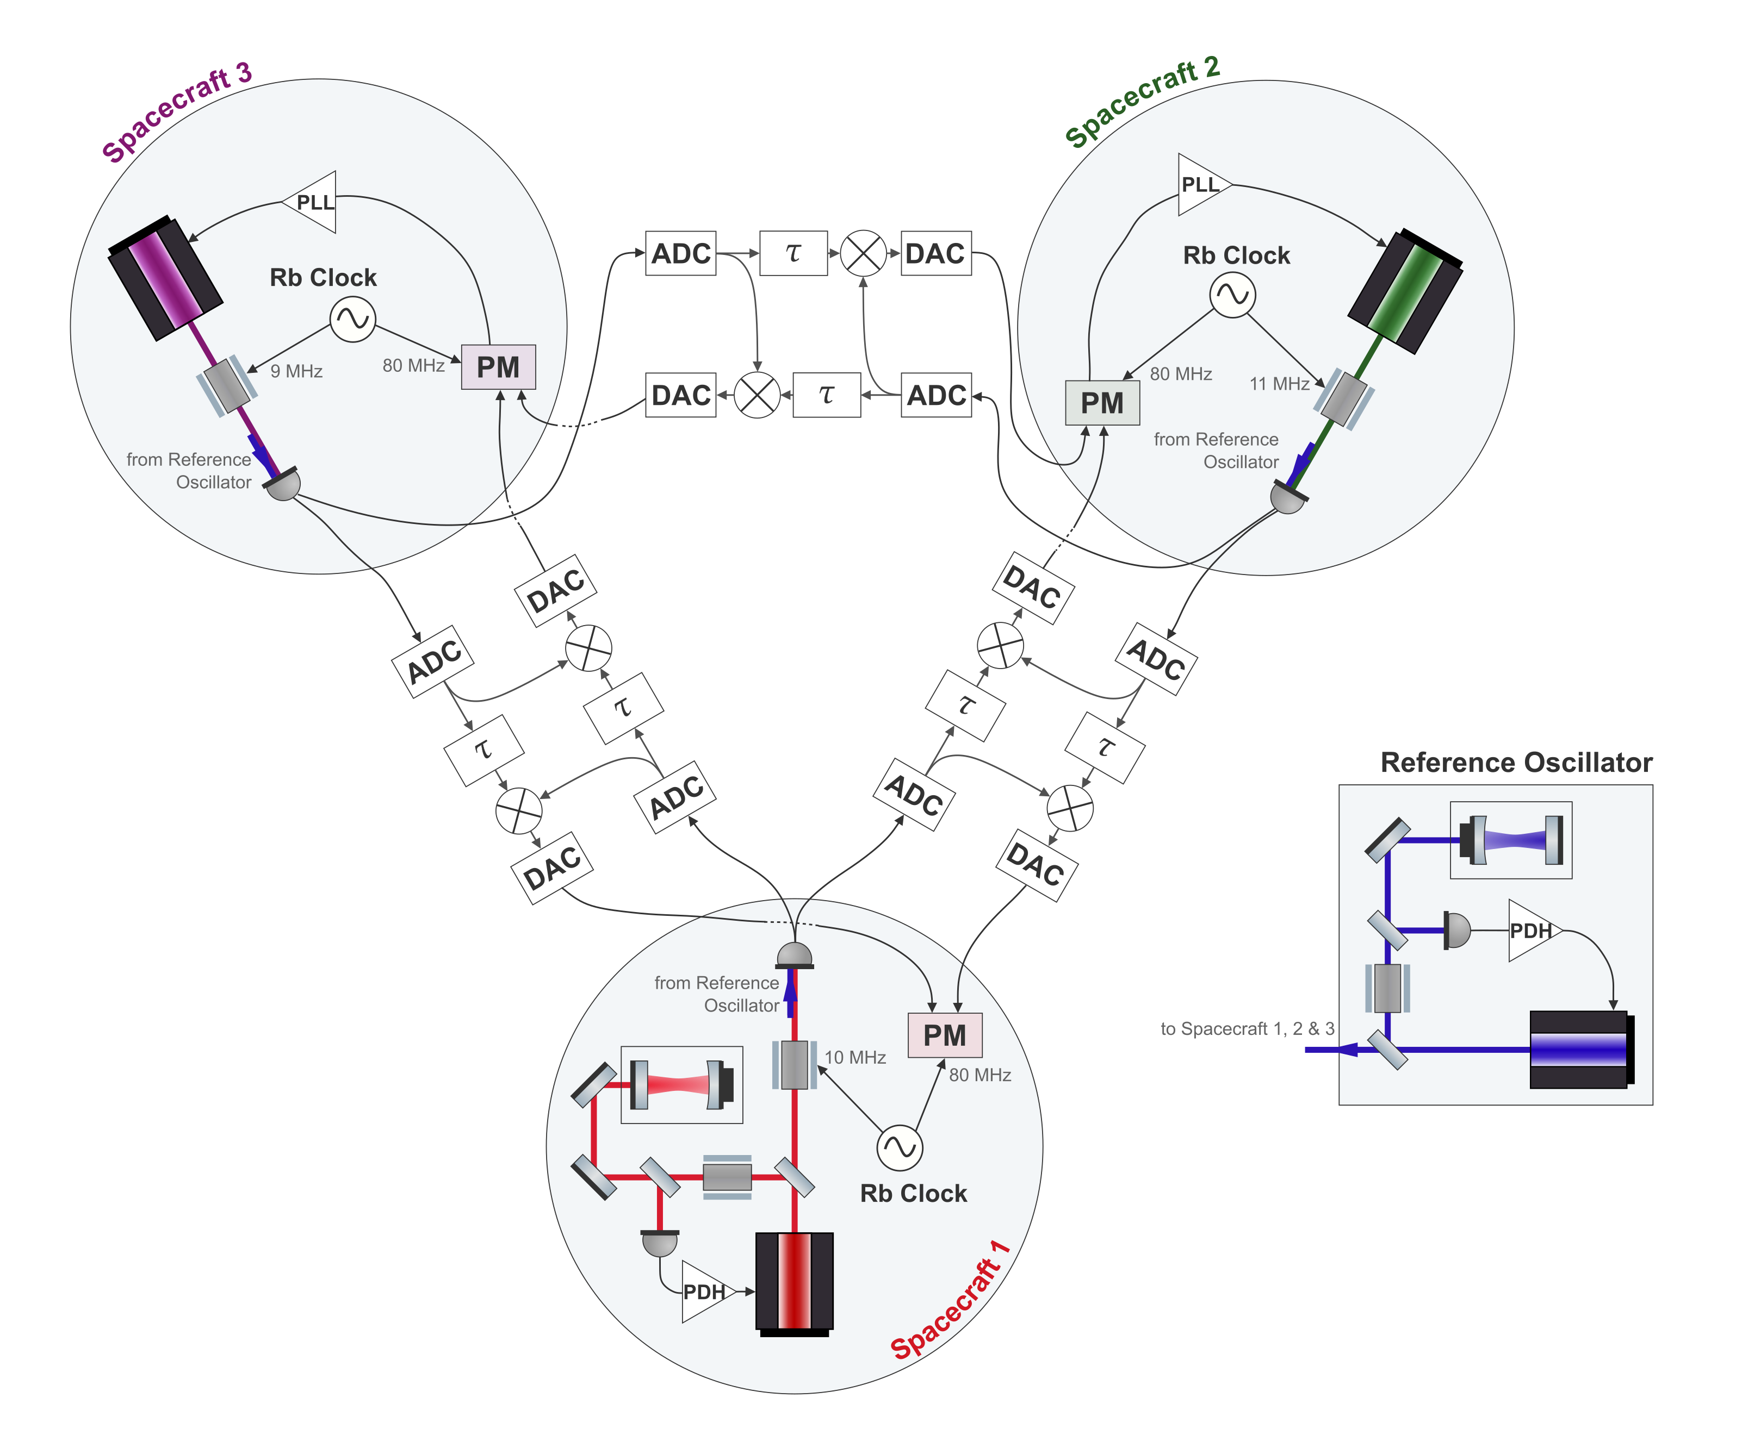
Full Testbed
One laser per spacecraft
Cavity locked primary laser
Independent clocks
Six separate delay lines
Notes:
Lasers, delaylines, locking, add pic of lab

Slide 8
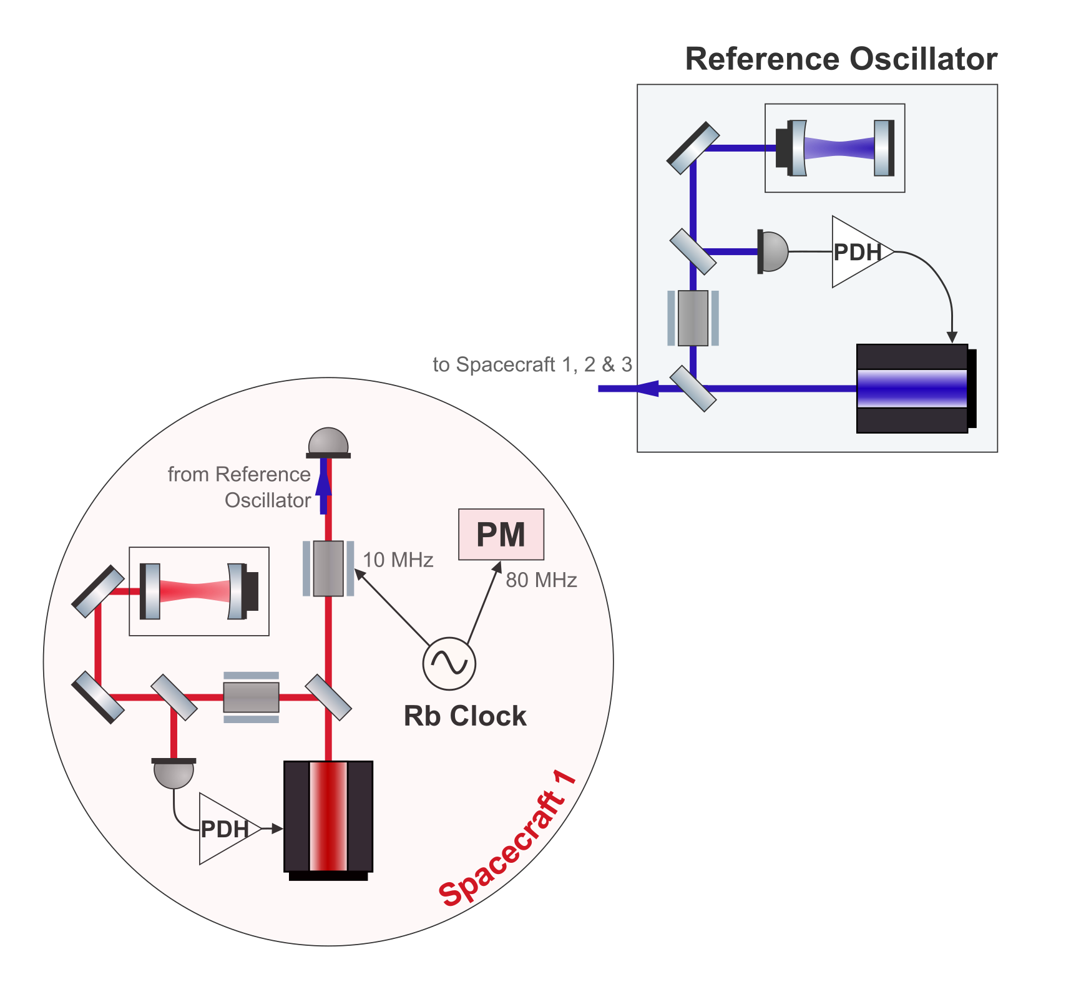
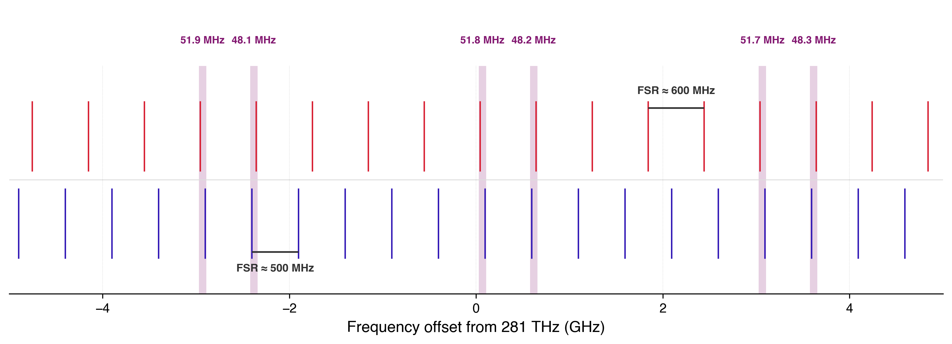
Cavity Locking Two Lasers
For LISA-like laser noise the primary laser should be cavity locked.
Two lasers locked to separate cavities – 25 cm and 30 cm
Two separate Pound-Drever-Hall (PDH) locks
Beat note needs to be below 60 MHz
Illustrative cavity resonances
Notes:
The length variability, like how it affects the
more fluent – streamline the talking about the pair of resonances

Slide 9
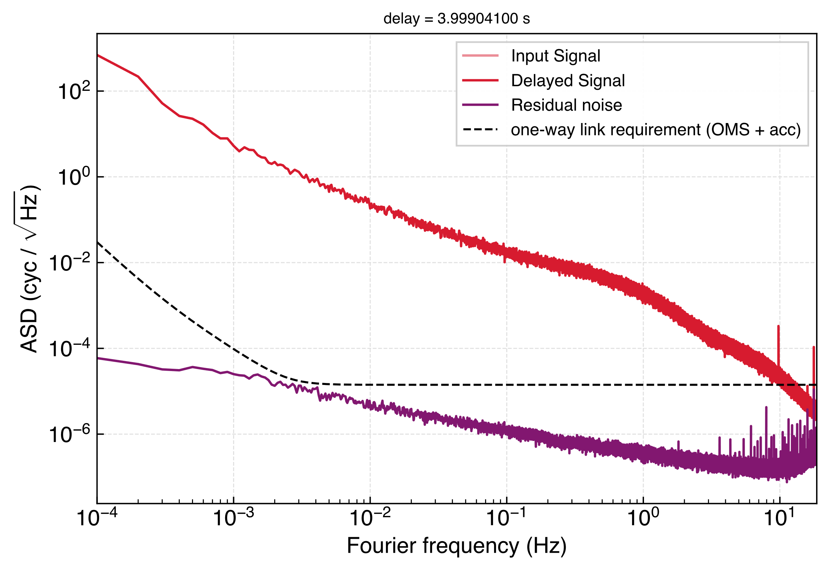
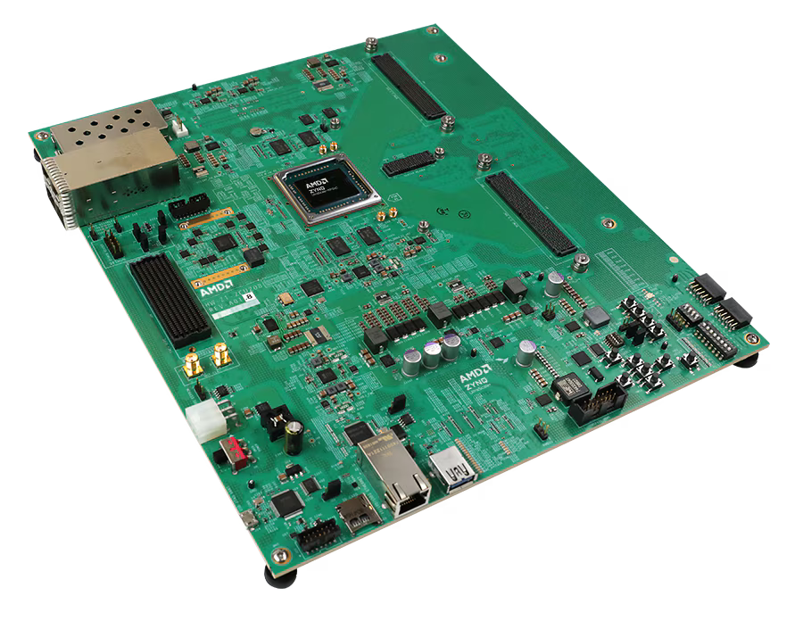
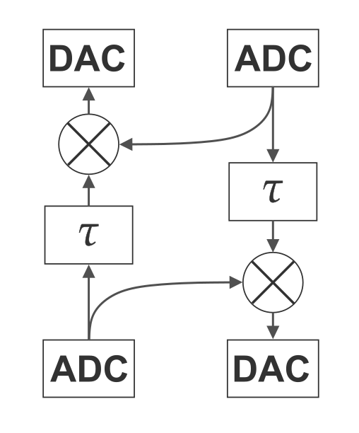
Delay Line
Time varying delays
Doppler shifts for both the carrier and sidebands
Gravitational wave injection
AMD Zynq™ UltraScale+™ RFSoC ZCU208 Evaluation Kit
Intrinsic noise floor of one board in purple
Notes:
Designed for softwawre RF

Slide 10
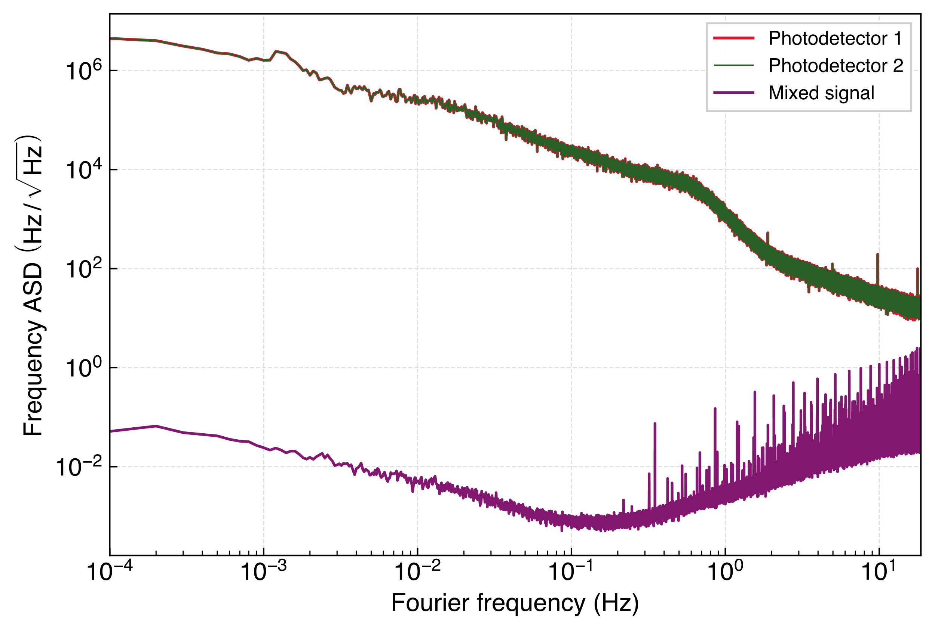

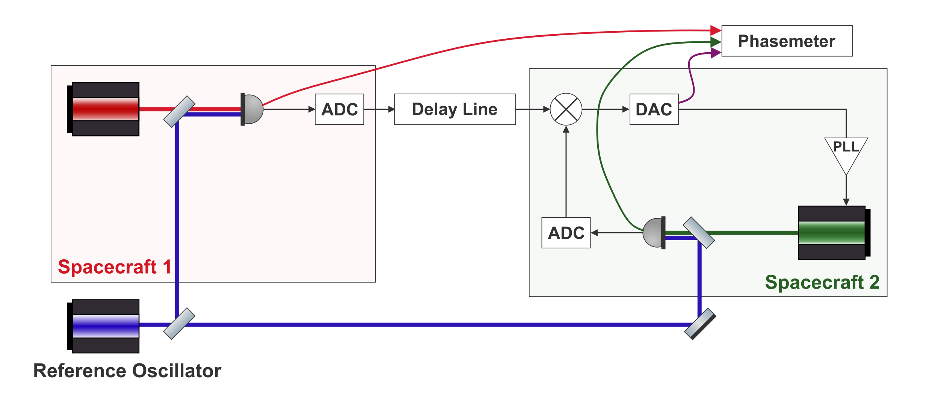

PLL Lock of Far Spacecraft
Photodetector readings are dominated by free running laser frequency noise.
Mixed output is orders of magnitude lower.
Notes:
Dont have the PM in the SC add the out of loop noise on the plot

Slide 11
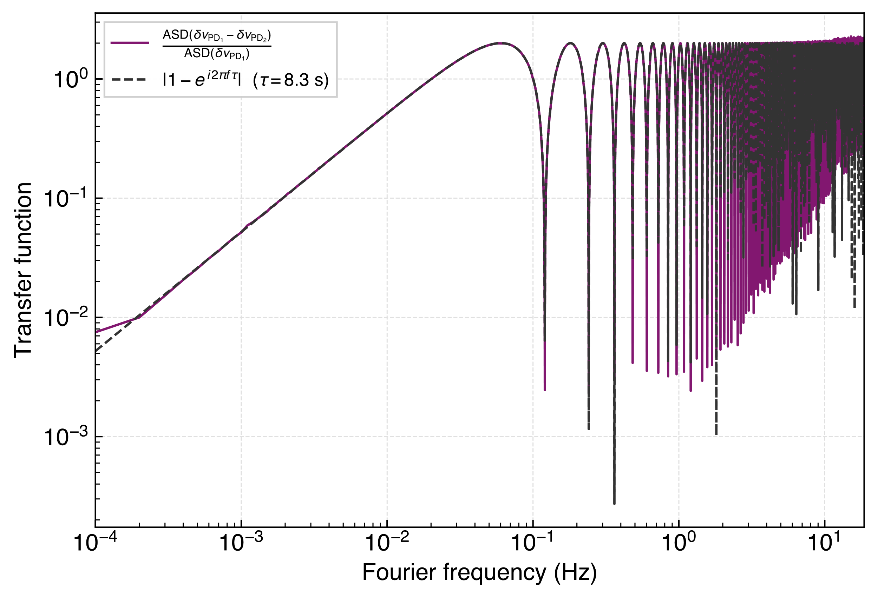

PLL Lock of Far Spacecraft
We can recover a LISA-like one-way laser noise transfer function
Notes:
Explain the extraction clearly this is results w the LFN, this has been done in Florida
Transistion from LFN to clock noise, mention Florida, higher phase fidelity, tech and added clocks Show TDI and GW injection, like we can do that w the electronics (at the expense of the clock noise time)

Slide 12
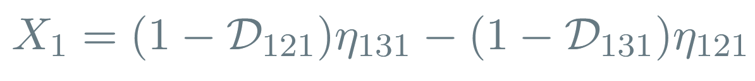
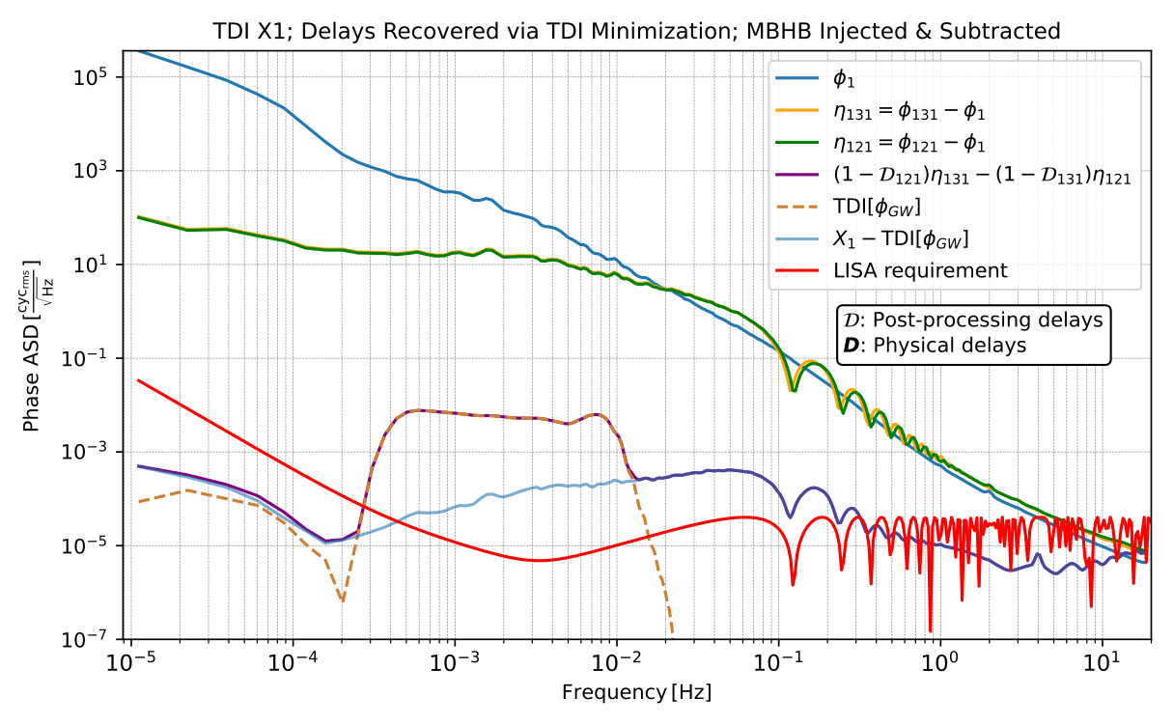
Tests of TDI so Far
Fully electronic tests of TDI with and injected signal
Credit: R. Ferguson
Notes:
Update! If shown, show later

Slide 13
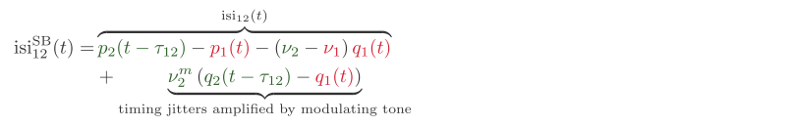
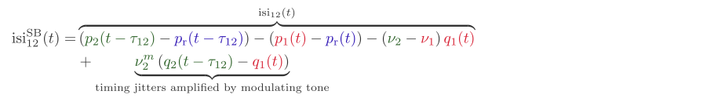
Sidebands in the Lab
LISA arm
Testbed arm
Notes:
Highlight the modulation frequency in the text, explain the GHz limitation better

Slide 14
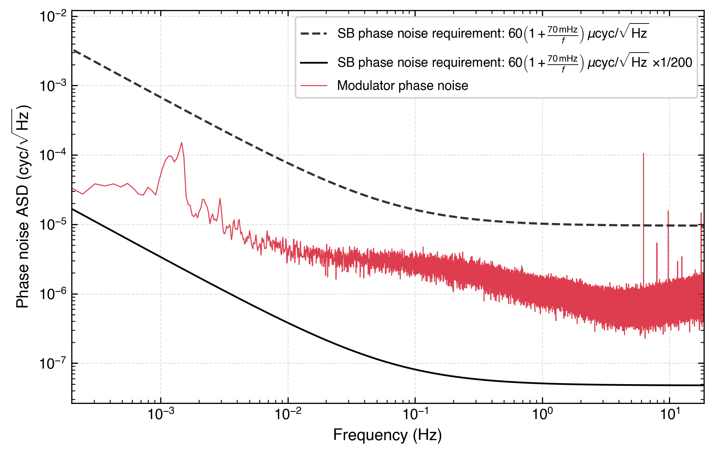
Clock Tone Transfer Limitation
Modulator noise remains too loud if MHz modulation is used.
RF Sideband phase noise requirement should be adjusted for the modulating frequency used.
Notes:
This is extreme case, we are exploring some ideas, like why the factor of 200

Slide 15
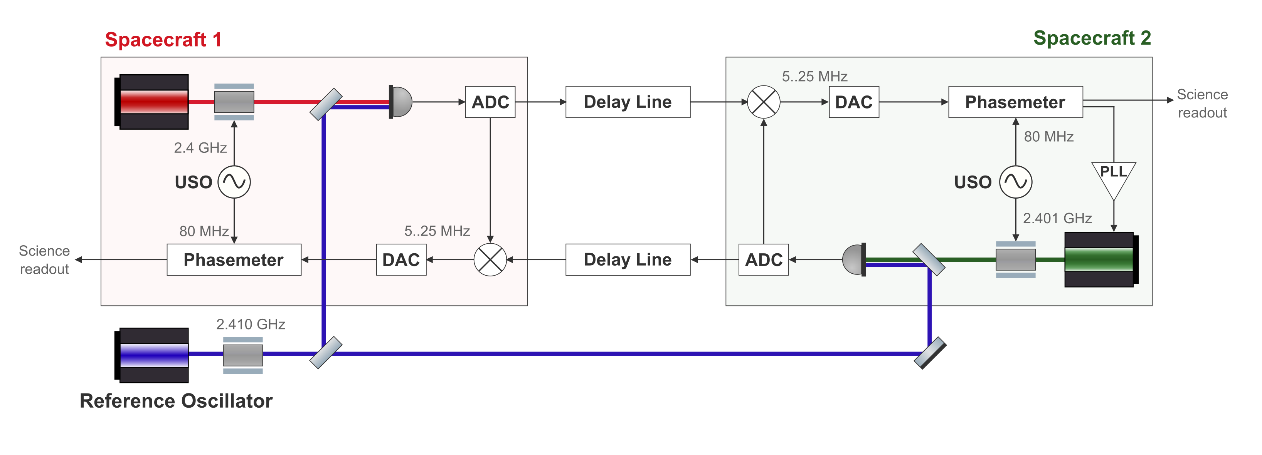
GHz Modulation
To use GHz modulation
Notes:
May be bullet lines, PM clocking from SB, reference meas, ADC mixing, aliasing, and no ref measuremtn version

Slide 16

Conclusions and Next Steps
✓ Delay line — working, below requirement
✓ PLL lock demonstrated with free running lasers
○ Assembling the optical layout and cavities
○ GHz sideband chain — under investigation
○ Delay board clock noise removal
○ Full TDI and clock noise removal
Thank you for listening!
Notes:
Fix the clock noise stuff
Add the cavity locking plans? – how u get the good beatnote (in the right range)
Take out delay line stuff, like put them together

Slide 17
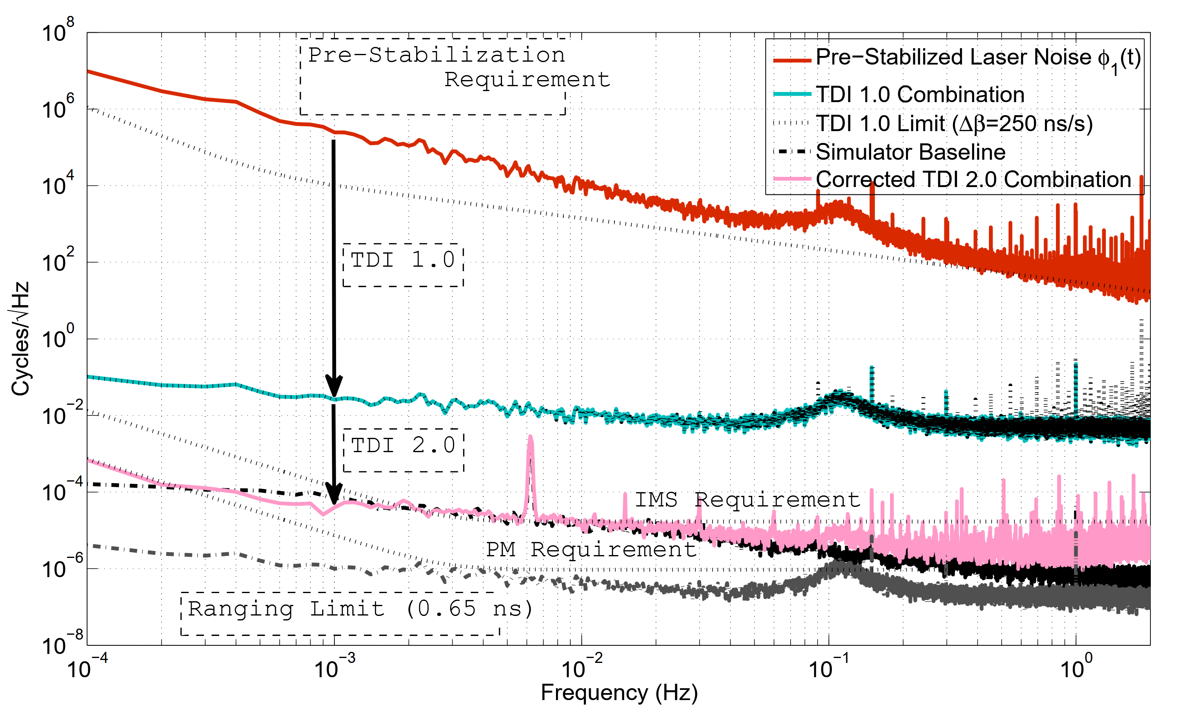
Predecessor Testbed
Results from University of Florida Laser Interferometry Simulator
TDI 1.0
Strain amplitude 4.35×10⁻²⁰
TDI 2.0
Credit: Mitryk, 2012

Slide 18
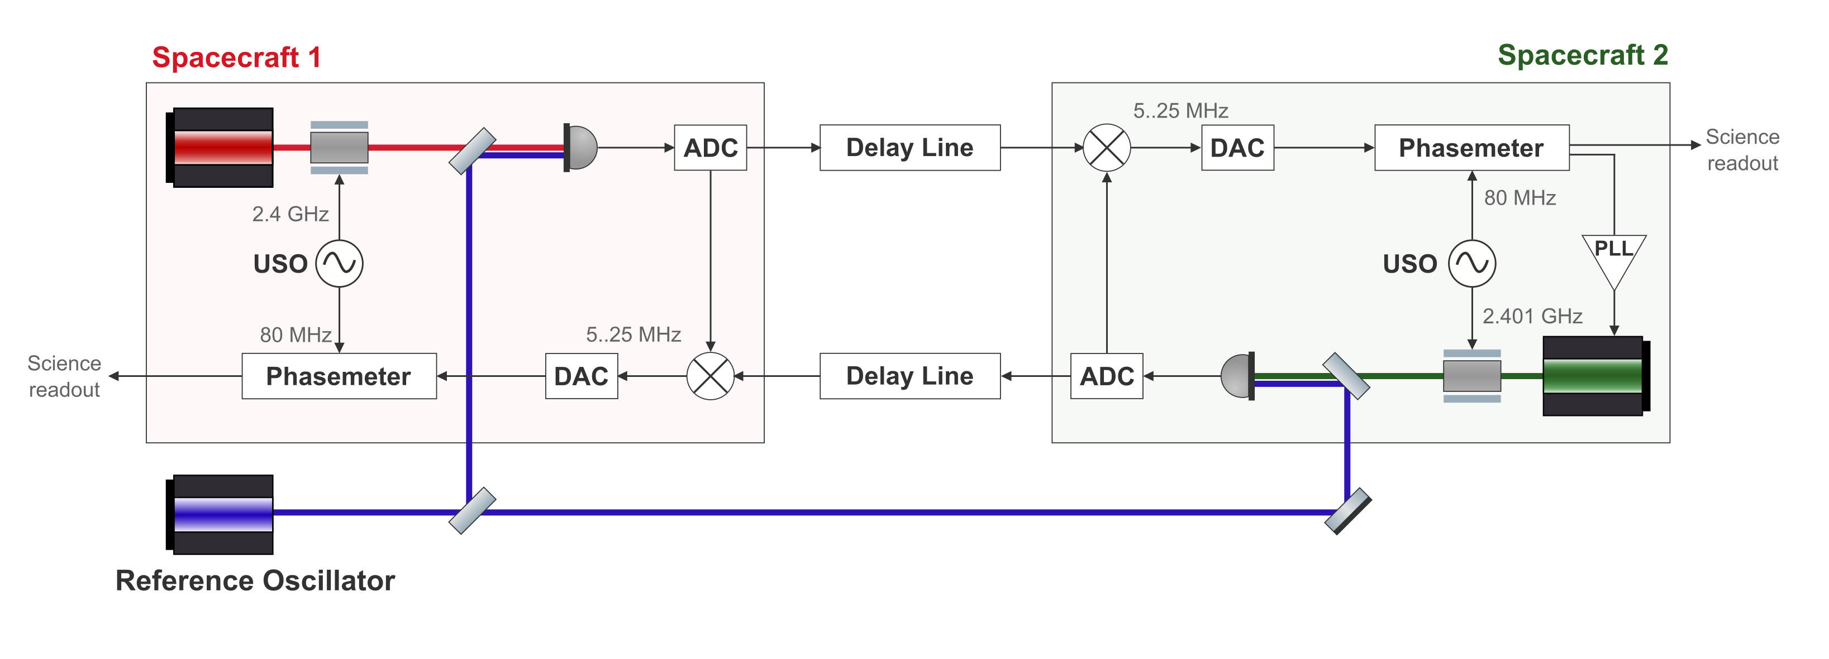
GHz Modulation – Option 2
Mixing of a GHz signal in the ADC – effectively increasing the bandwidth of the input of the electronics to 5 GHz.
Internal IQ demodulation
Notes:
Our firmware currently doesn’t allow for GHz “front end”. Solution nr 2, add Clarify the solution properly. Like why is this even an issue currently internal IQ demodulation --

Slide 19
Clock Noise Transfer in LISA
Notes:
Clarify the modulating freq.
Add clarifing notes for the terms/frequencies (already in previous slides)

Slide 20
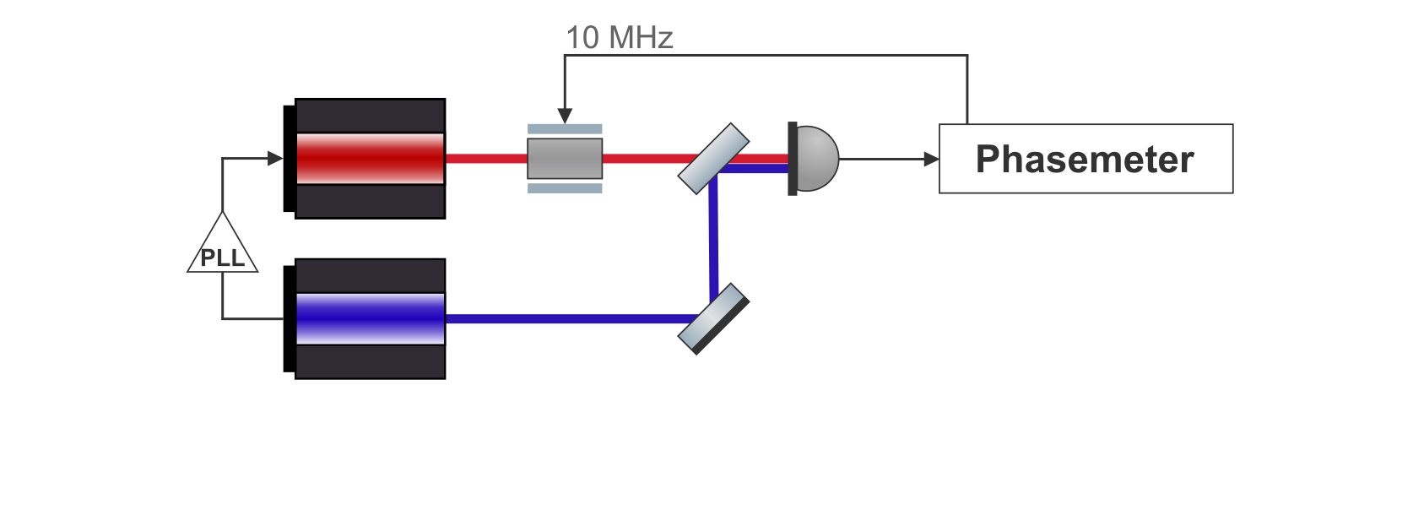
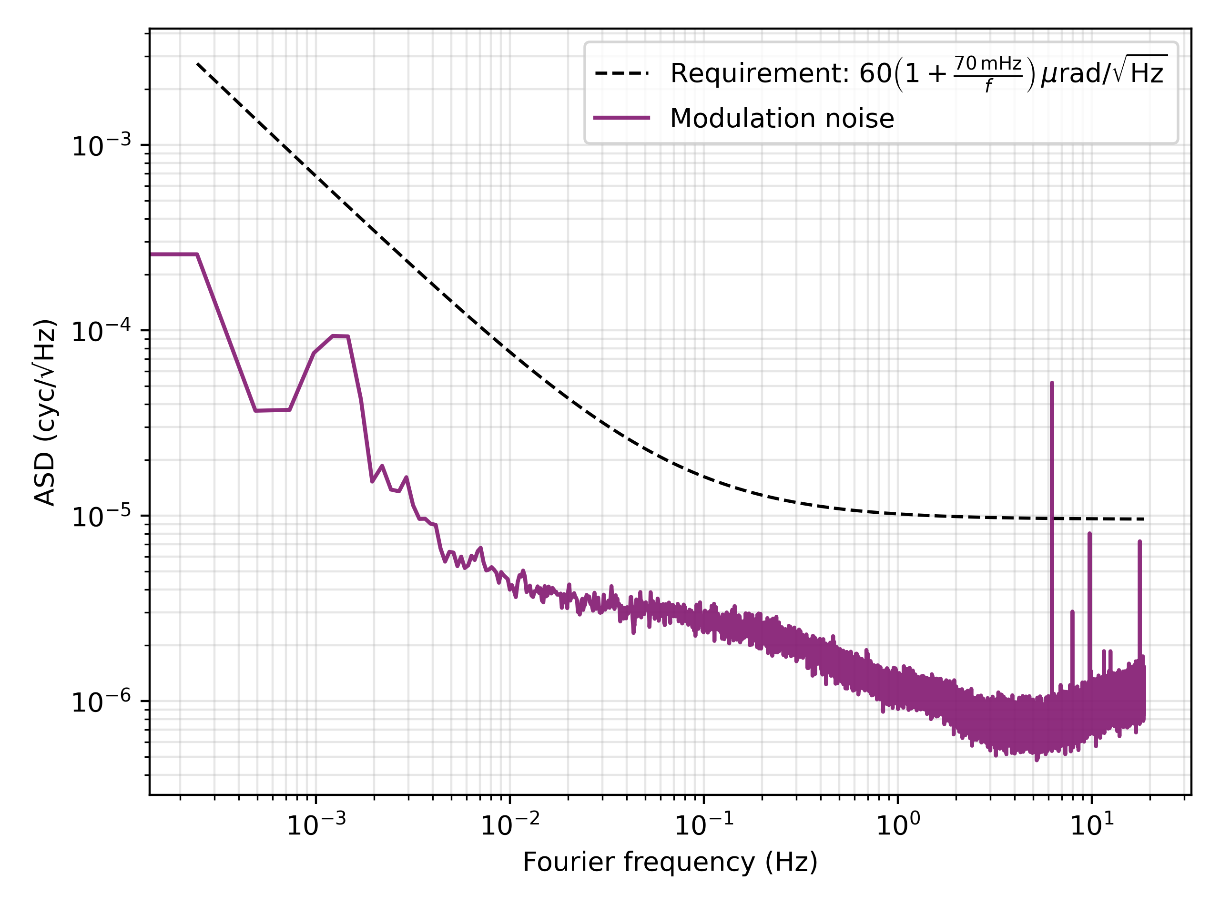
Modulation Noise Characterization
Notes:
Add fibers?

Slide 21
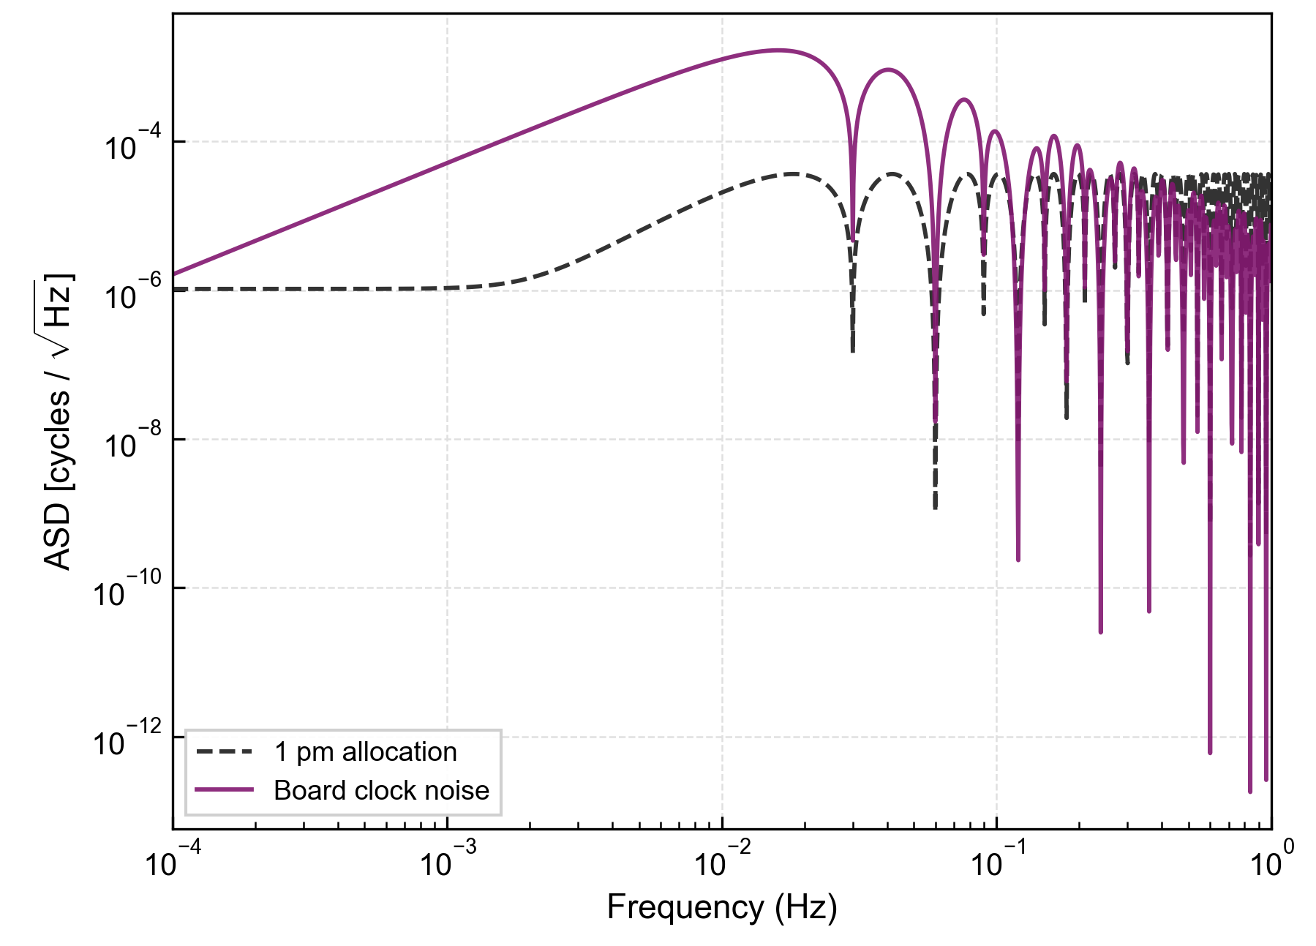
What to do with the clock noise?
Tests of Delay Line Board Clock Phase Noise
We are working on another layer of post processing remove this noise
Can be done after TDI and LISA-like clock noise removal
Only if the residuals are added
And rhen other noises should also be added
Notes:
Add something that indicates the residuals

Slide 22
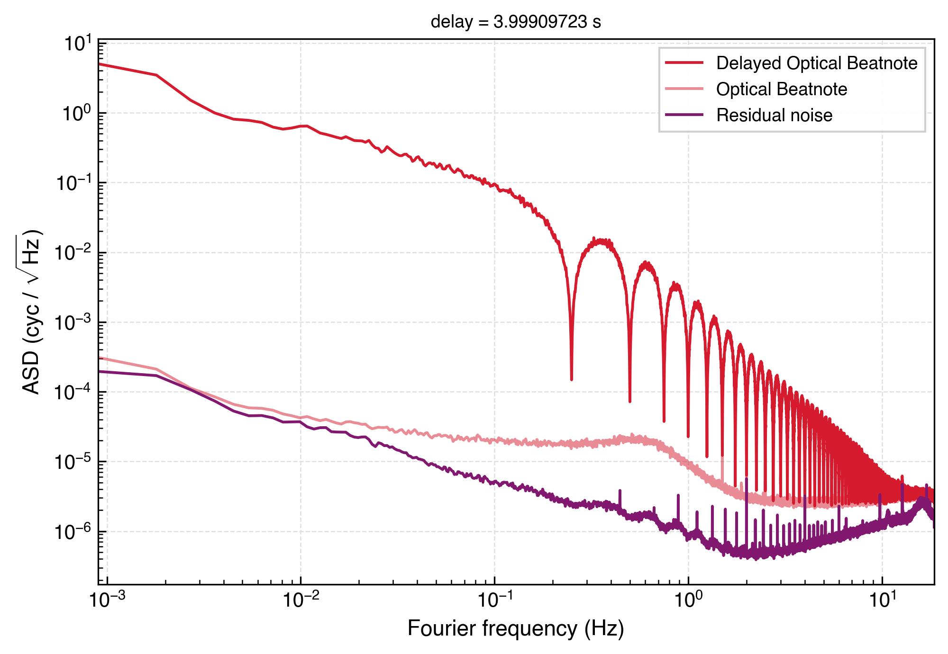
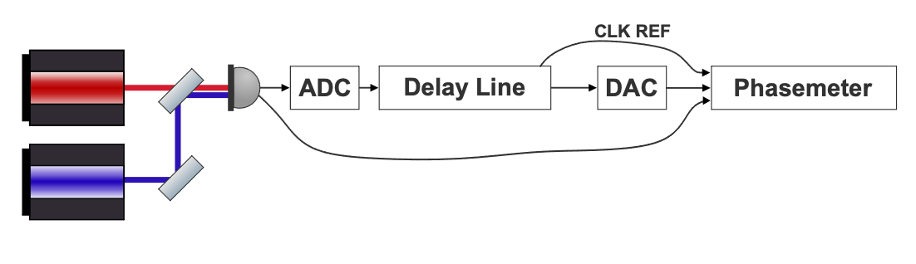
Experiments so Far
Tests of Delay Line Board Clock Phase Noise
A new baseline measurement with an optical signal and free running delay line board clock reveals a potential problem.
Notes:
Take out

Slide 23
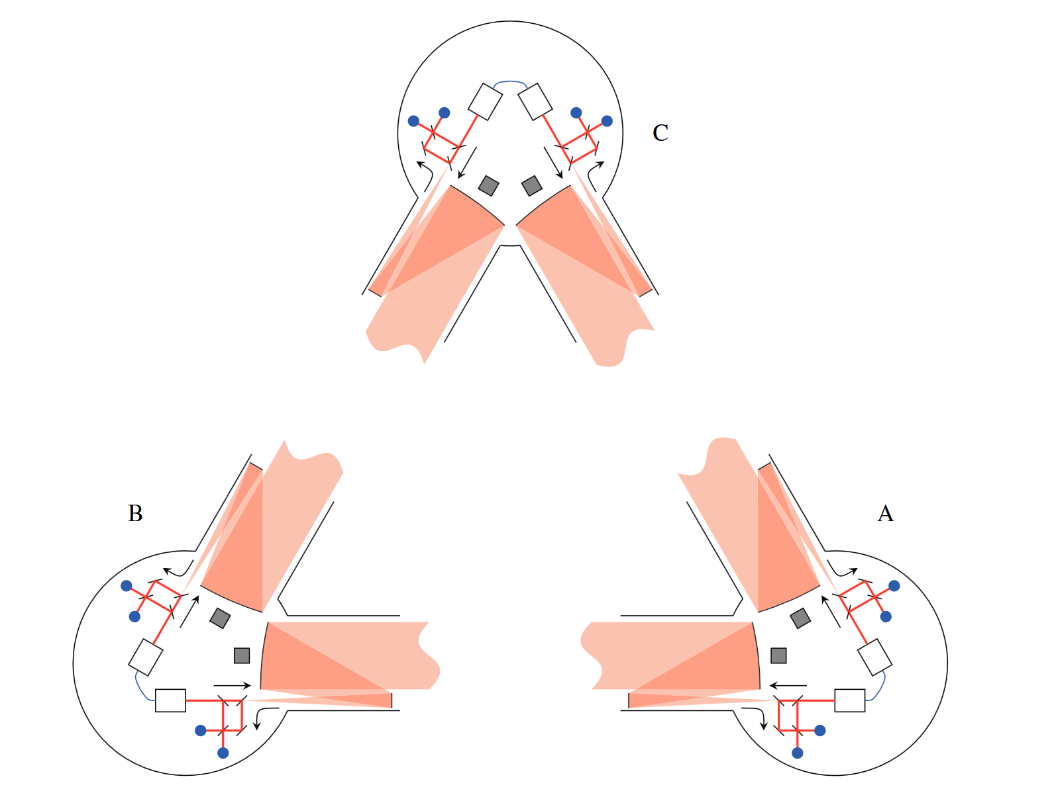
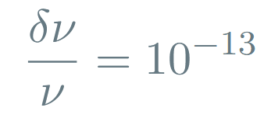
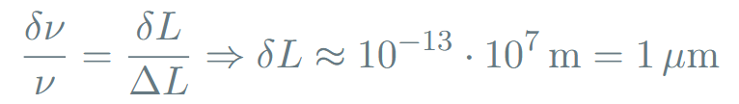

LISA Laser Frequency Noise
As per LISA requirements
Unequal arm lengths and laser frequency noise
Hence for the arm length uncertainty we get
But to be sensitive enough to detect GWs, we need
Credit: Jennrich, 2010

